Slide 1
Introdution to Sockets

Slide 2
What is a socket?
• The socket is the BSD method for accomplishing inter-process communication (IPC).
• It is used to allow one process to speak to another (on same or different machine).
– Analogy: Like the telephone is used to allow one person to speak to another.
• Works very similar to files.
– Socket descriptor _very similar to file descriptor.
– Read/write on a socket and file are very similar.

Slide 3
Basic Idea
When two processes located on the same or different machines communicate, we define association and socket.
– Association: basically a 5-tuple
• Protocol
• Local IP address
• Local port number
• Remote IP address
• Remote port number
– Socket: also called half-association (a 3-tuple)
• Protocol, local IP address, local port number
• Protocol, remote IP address, remote port number

Slide 4
More about sockets
Creating a socket is the first step in network programming using BSD socket interface.
– Using the socket() system call.
• Two main addressing formats of a socket:
– AF_UNIX: uses Unix pathnames to identify sockets, and are very useful for IPC between processes on the same machine.
– AF_INET: uses IP addresses.
• In addition to machine address, there is also a port number that allows more than one AF_INET socket on each machine.

Slide 5
Types of socket
Two most common types:
– SOCK_STREAM: Stream sockets, which provide reliable, two-way, connection-oriented communication streams. <Uses TCP>
– SOCK_DGRAM: Datagram sockets, which provide connectionless, unreliable service, used for packet-by-packet transfer of information. <Uses UDP>
• Other types like SOCK_RAW also exist.
– Beyond the scope of the present discussion.

Slide 6
Systems calls for using sockets
• socket()
• bind()
• connect()
• listen()
• accept()
• send() & recv()
• sendto() & recvfrom()
• close() & shutdown()
• getpeername()
• gethostname()
• gethostbyname()

Slide 7
socket() :: Get the Socket Descriptor
• General syntax:
– domain: should be set to AF_INET (typically)
– type: should be set to SOCK_STREAM or SOCK_DGRAM
– protocol: set to zero (typically)
• Returns: socket descriptor; -1 on error
#include <sys/types.h>
#include <sys/socket.h>
int socket (int domain, int type, int protocol)

Slide 8
bind():: What Port am I on?
Used to associate the socket with an address
• General syntax:
– sockfd: socket file descriptor returned by socket()
– my_addr: pointer to a structure that contains information about the local IP address and port number.
– addrlen: typically set to sizeof(struct sockaddr)
• Returns: -1 on error
#include <sys/types.h>
#include <sys/socket.h>
int bind (int sockfd, struct sockaddr *my_addr, int addrlen);

Slide 9
The sockaddr Structure
struct sockaddr
{
unsigned short sa_family;
char sa_data[14];
}
struct sockaddr_in
{
short int sin_family;
unsigned short int sin_port;
struct in_addr sin_addr;
unsigned char sin_zero[8];
}
sockaddr_in is a parallel structure to sockaddr which a programmer uses
in the program for convenience.
struct in_addr
{
unsigned long s_addr;
}

Slide 10
connect(): Connect to a Remote Socket
• General syntax:
– sockfd: socket file descriptor returned by socket()
– serv_addr: pointer to a structure that contains the destination IP address and the port number
– addrlen: typically set to sizeof(struct sockaddr)
• Returns: -1 on error
#include <sys/types.h>
#include <sys/socket.h>
int connect (int sockfd, struct sockaddr *serv_addr, int addrlen);

Slide 11
listen(): Get Set for Incoming Connections
• Here, we wish to wait for incoming connections and handle them in some way.
– Two steps, first you listen(), then you accept().
• General syntax:
– sockfd: socket file descriptor returned by socket().
– backlog: used to set the maximum number of requests (up to a maximum of about 20) that will be queued up before requests start being denied.
• Returns: -1 on error
int listen (int sockfd, int backlog);

Slide 12
accept(): Waiting for Incoming Connections
• Basic concept:
– Someone far away will try to connect() to your machine on a port that you are listen()’ing on.
– Such connections will be queued up waiting to be accept()’ed.
– accept() returns a brand new socket file descriptor to use for every single connection.
• Two socket file descriptors!!
– The original one is still listening on your port.
– Newly created one is finally ready to send() and recv().

Slide 13
accept(): contd..
General syntax:
– sockfd: listen()’ing socket descriptor
– addr: pointer to a local struct sockaddr_in (This is where the information about the incoming connection will go)
– addrlen: local integer variable that should be set to sizeof(struct sockaddr_in) before accept() is called.
• Returns: -1 on error
#include <sys/socket.h>
int accept (int sockfd, void *addr, int *addrlen);

Slide 14
send() and recv(): Sending/receiving Data
• Used for communicating over stream sockets or connected datagram sockets.
• General syntax:
– mesg: a pointer to the data you want to send
– len: length of the data in bytes
– buf: buffer to read the information into
– flags: typically set to 0
• send() returns the number of bytes actually sent out, and recv() returns
the number of bytes actually read into the buffer.
int send (int sockfd, const void *mesg, int len, int flags);
int recv (int sockfd, void *buf, int len, unsigned int flags);

Slide 15
sendto() and recvfrom()
Used to transmit and receive data packets over unconnected datagram sockets.
• General syntax:
If you connect() a datagram socket, you can then simply use send() and recv() for all your transactions.
int sendto (int sockfd, const void *msg, int len, unsigned int flags,
const struct sockaddr *to, int tolen);
int recvfrom (int sockfd, void *buf, int len, unsigned int flags,
struct sockaddr *from, int *fromlen);

Slide 16
close() and shutdown()
Used to close the connection on the socket descriptor.
• This prevents any more reads and writes to the socket.
• how=0 _further receives are disallowed
• how=1 _further sends are disallowed
• how=2 _further sends and receives are disallowed (like close())
close (sockfd);
int shutdown (int sockfd, int how);

Slide 17
getpeername()
• This function will tell you who is at the other end of a connection stream socket.
– sockfd: descriptor of the connected stream socket
– addr: pointer to a structure that will hold the information about the
other side of the connection
– addrlen: pointer to an int that should be initialized to sizeof(struct sockaddr)
#include <sys/socket.h>
int getpeername (int sockfd, struct sockaddr *addr, int *addrlen);

Slide 18
gethostname()
This function returns the name of the computer that your program is running on.
– This name can be used by gethostbyname() to determine the IP address of the local machine.
– hostname: pointer to an array of chars that will contain the host name upon the function’s return.
– size: length in bytes of the hostname array.
#include <unistd.h>
int gethostname (char *hostname, size_t size);

Slide 19
gethostbyname()
Returns the IP address of a host given its name.
– Invokes the Domain Name Server (DNS).
– Returns a pointer to a struct hostent:
#include <netdb.h>
struct hostent *gethostbyname (const char *name);
struct hostent
{
char *h_name; /* official name of the host */
char **h_aliases; /* NULL terminate array of alternate names */
int haddrtype; /* Type of address being returned (AF_INET) */
int h_length; /* Length of the address in bytes */
char **h_addr_list; /* Zero terminated array of network addresses */
};
#define h_addr h_adr_list[0];

Slide 20
Client-server Model
Standard model for network applications.
– A server is a process that is waiting to be contacted by a client process so as to provide some service.
• Typical scenario:
– The server process is started on some computer system.
• Initializes itself, then goes to sleep waiting for a client request.
– A client process is started, either on the same system or on some other system.
• Client sends a request (across the network) to the server.
– When the server process has finished providing its service to the client, the server goes back to sleep, waiting for the next client request to arrive.

Slide 21
Client-server Model (contd.)
Roles of the client and the server processes are asymmetric.
• Two types of servers:
– Iterative servers: Used when the server process knows in advance how long it takes to handle each request and it handles each request itself.
– Concurrent servers: Used when the amount of work required to handle a request is unknown; the server starts another process to handle each request.

Slide 22
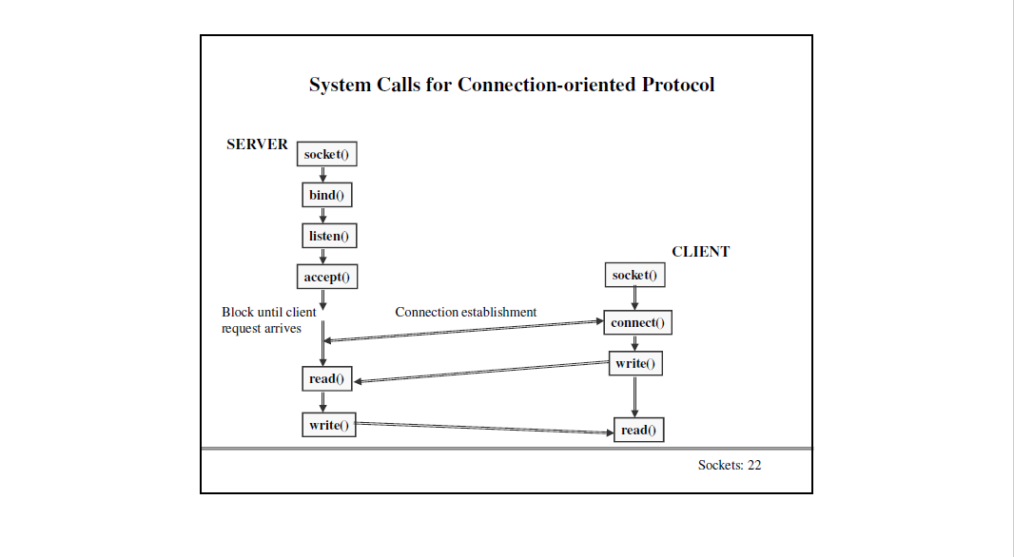
System calls for Connection-oriented Protocol

Slide 23
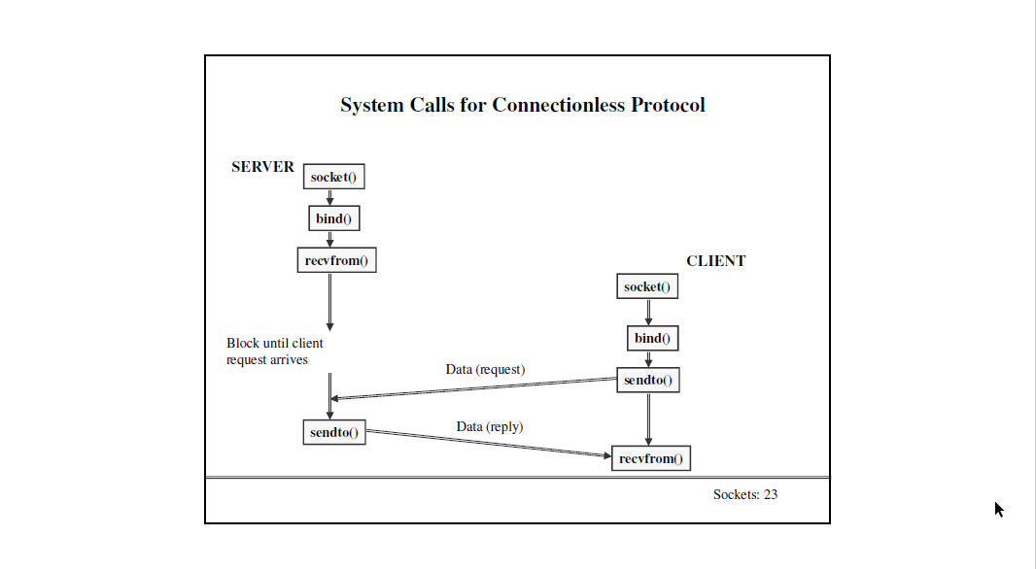
System calls for Connectionless Protocol

Slide 24
References
Unix Network Programming
W.R.Stevens, Prentice-Hall of India, 1992.
• Internetworking with TCP/IP (Volume I,II,III)
D.E.Comer and D.L.Stevens, Prentice-Hall of India, 1995.
• http://www.ecst.csuchico.edu/~beej/guide/net

